Slide 1
Inception Phase:
The Scrumbags
Chris Byam, Jacob Nelson, Robert Voit, Ben Candell, TJ Marrapodi

Slide 2
Process Sale UC: Main Success Scenario
The customer brings items to either the cashier operated cash register. The cashier scans each item or manually enters its product ID as well as the quantity purchased. At this point, the system fetches the price per item from the database, multiplies it by the quantity purchased, and displays it on the cashier’s monitor as a list of purchased items. After all items have been accounted for, the final price is displayed on the monitor. Then, a 3rd party tax software is used to calculate the amount of the tax, which is displayed on the monitor and added to the total price. If customer pays with credit, the card is swiped or the card number is manually entered, and a 3rd party software is used to perform a credit check on the credit card number. Once the credit check is verified, the system updates accounts receivable and inventory of items purchased in the database. If customer pays with cash, cashier enters amount of cash paid into the keyboard. The system then subtracts that amount from the total price, including tax, to determine the customer’s change. Then, the cashier retrieves the change from the cash register and gives it to the customer.

Slide 3
Process Sale UC: Extension Scenarios
Cashier or customer enters wrong product ID or item doesn’t scan correctly. System should effectively communicate with the cashier or customer what went wrong. Customer or cashier enters the wrong quantity of items purchased. There should be a “delete item” option so that the customer or cashier can remove an item from the list and re-enter the quantity purchased. Credit card is not verified by credit check. In this situation, system should gracefully resume to control and inform the cashier or customer that the credit card was not approved. System updates inventory with incorrect quantity of items purchased. System should verify that the quantity of items purchased is the same as the quantity being deducted from inventory. Multiple registers try to update inventory at one time. System needs to be able to lock data to ensure no loss of information.

Slide 4
Glossary
Item- product or service for sale; purchased in some quantity
Credit Check- 3rd party software interacts with POS system to verify credit history of credit card number in use
Tax Software- 3rd party software interacts with POS system to calculate sales tax based on location
Product ID- unique ID for each item; primary key in database
Monitor- terminal screen that the cashier can track the processing of a sale
Error- An easy to understand message to the cashier that is generated by the system on either an error or a successful transaction
Transaction- entails the product ID of item(s) purchased, quantity, price, date, time, location, customer name
Rental- similar to sale, except has extra attribute: returnDate
Role- determines an employee’s system privileges (cashier or manager in our system)

Slide 5
Process Rental UC: Main Success Scenario
A customer arrives at checkout with items to rent. The Cashier uses the POS system to record each rented item. The system presents a running total and line-item details. The customer enters payment information, which the system validates and records. The system updates inventory. The customer receives a receipt from the system and then leaves with the items.

Slide 6
Process Rental UC: Extension Scenarios
If, at any time, the customer decides not to go through with transaction, the Cashier uses the clear function and no rentals are recorded.
If the item identifier is not found in the system, notify the Cashier and suggest manual entry of the identifier code (perhaps it is corrupted).
If, at any time, the system fails, the last state should be recovered. If not, no rentals should have been recorded and the Cashier starts transaction over.
If the customer paid by credit, and their transaction is declined, inform the customer and request payment in cash. If the customer has no cash, clear the transaction.
If the system detects failure to communicate with the external accounting system, save the transaction as a text file for manual entry.

Slide 7
POS Business Rules
ID | Rule | Changeability | Source
RULE 1 | Signature required for all payments by credit. | Clients may want signature to be captured on a digital device. For our purposes, just focus on paper signatures. | Almost all credit companies
RULE 2 | Tax code must be adhered to | Tax laws are constantly changing at all levels of government | Law
RULE 3 | Customers can only receive credit to their cards, not as cash | Low | credit authorization company policy

Slide 8
Handle Return UC: Main Success Scenario
Scenario: A customer arrives with one or more items to return, and the receipt used to purchase the items. The cashier collects the items and uses the POS system to record each returned item one by one. The system asks the cashier to confirm, and then updates inventory accordingly. If the customer paid with a credit card, the system reimburses the credit card. If the customer paid with cash, the cashier reimburses them with store credit.

Slide 9
Handle Returns UC: Extension Scenarios
If the customer paid by credit and the reimbursement to their card is rejected, the system informs the cashier, who relays the message to the customer, and gives the customer store credit instead.
If the customer tries to return an item that is not found in the system after scanning, the system displays the error and asks the cashier to try again.
If the cashier scans an item and then the customer decides he does not want to return that item, the cashier deletes that item from the total.

Slide 10
Work Breakdown Structure
1. Complete casual use cases that include extension scenarios (5 hrs)
Process Sale (1 hr)
Process Rental (1 hr)
Handle Return (1 hr)
User Management (1 hr)
Power on\off System (1 hr)
2. Develop select casual use cases into fully­ dressed use cases (2 hrs)
Process Sale (1 hr)
Handle Rental (1 hr)
3. Create several of each of the following artifacts that aren’t use cases (4.5 hrs)
Business Rules (1 hr)
Vision (1 hr)
Glossary (.5 hrs)
Supplementary Specifications (2 hrs)

Slide 11
Responsibility Matrix
 | TJ | Chris | Jacob | Bobby | Ben
Process Sale (Casual)
Process Rental (Casual)
Handle Return
User Management
Power on/off System
Process Sale (fully dressed)
Handle Rental (fully dressed)
Business Rules
Vision
Glossary
Supplementary Specifications

Slide 12
User Management UC: Main Success Scenario
An employee is hired and must make an account to be able to use the cash register. The employee must sign in and sign out on their shift standing at the register. From then on when a sale is made their name will appear in the transaction receipt. Unauthorized users cannot complete a sale. A new employee is hired and makes a new account. The employee signs in and is able to process sales without error occurring.

Slide 13
User Management UC: Extension Scenarios
An employee is not recognized by the system: From here they must enter their correct user ID or they cannot use the system. (Possible unique idea: If employee is not recognized allow for supervisor override)
Someone tries to open the register while nobody is looking: The register will not open unless an employee with access is making a sale/return at the register.
An employee is terminated or quits: Their account and access are terminated as well.
An employee is inactive for more than 10 minutes: Account locks and must re-enter credentials.

Slide 14
Vision

Slide 15
System Startup/Shutdown UC
Success scenario: Manager or qualified personnel initiates application startup by clicking application file. System boots up to a verification screen for secure access, to which only certain employees have access. To initiate sale, employee enters user ID and password. System tracks number of sales employee makes. Employee logs off the system after shift is over. Manager or qualified personnel uses password verification to power off the system at the end of the day, ensuring the system shuts down correctly and no data is lost.
Extension scenarios:
If for some reason the system shuts down prematurely or incorrectly, the last state should be recovered. When restarting the manager or qualified personnel should log in as would occur during normal startup, but the most recent state is rebooted.
If the previous state was corrupted and the system is unable to reboot correctly, normal startup is initiated and the system is reset.

Slide 16
Sup Specs

Slide 17
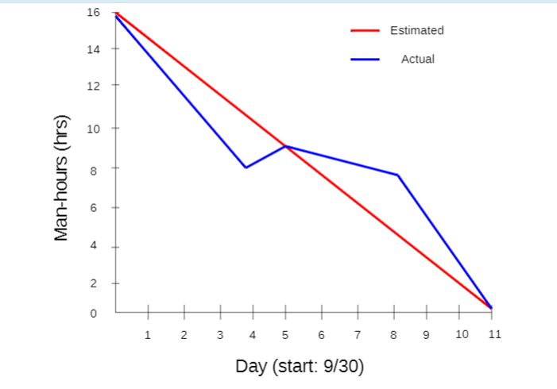
Burndown Chart Comparison

